Slide 1

Transferring Motion
The Antidote - FTC 14320

Slide 2
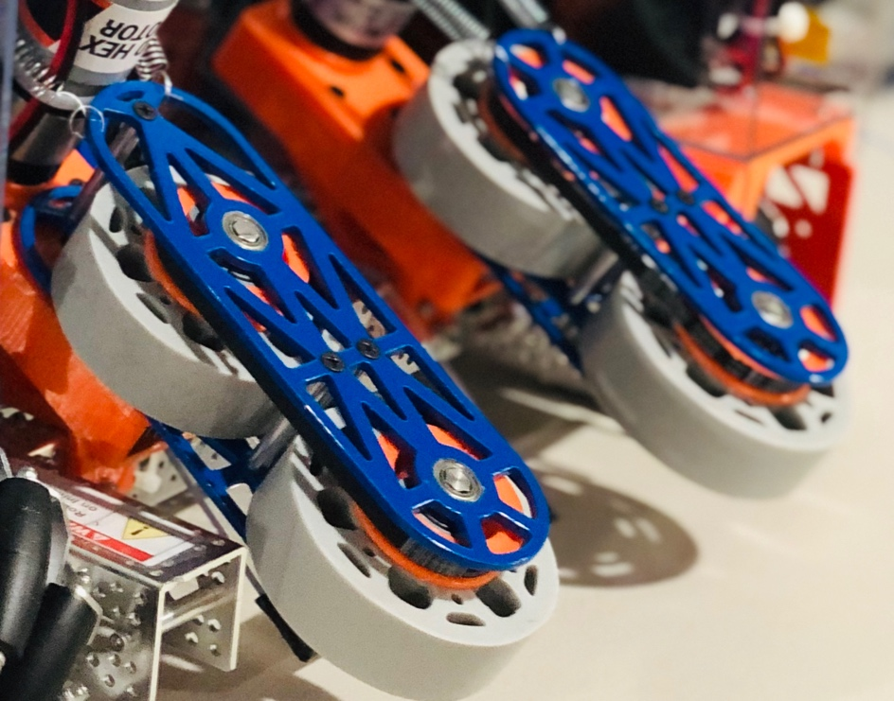
Motion
Most FTC mechanical systems require powered rotational motion of an object.
There are four main ways to connect an object to a motor or servo for transmission of powered rotation:
Direct Drive
Geared Drive
Chain Drive
Belt Drive
Our Intake mechanism for grabbing stones in the 19-20 season

Slide 3
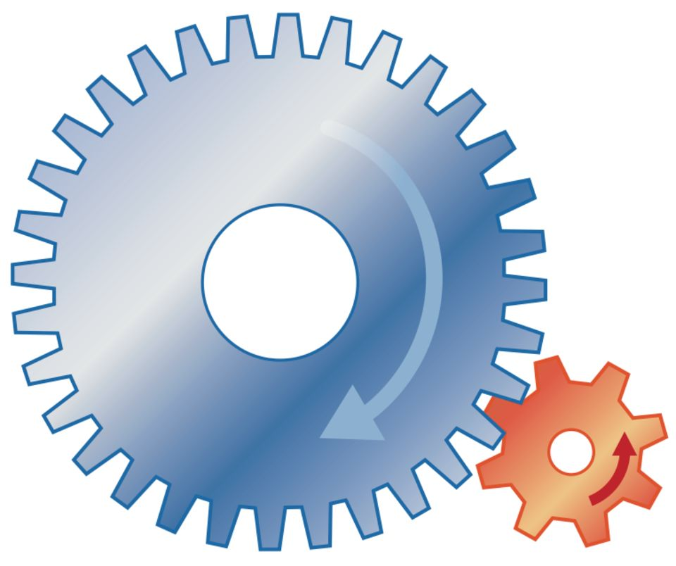
Vocabulary
Speed: Rotational velocity of a rotating object (Shaft, Gear, etc.).
Torque: Rotational force of a rotating object. Higher torque allows movement of heavier objects.
Driving: The gear, sprocket, or pulley which is turning another gear, sprocket or pulley, usually the one connected to the motor/servo.
Driven: The gear, sprocket or pulley which is being turned or driven.
Driving Gear
Driven Gear

Slide 4
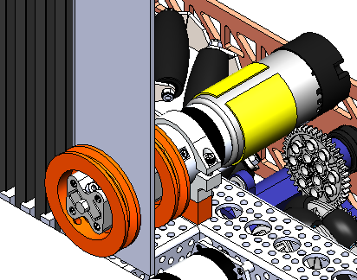
Direct Drive
Direct Drive is when the motor/servo is directly connected to an object via the drive shaft.
Motor
Directly driven winch system for linear slides
Rotating Winch

Slide 5
Direct Drive Pros & Cons
Pros:
Direct Drive is the most compact way of transferring rotation, allowing for compact designs
Directly driven systems are incredibly easy to create, perfect for prototyping or simple mechanisms
Cons:
Direct drive does not offer torque or speed reductions, so the powered object will spin at the same speed and with the same torque as the driving motor.
Any shock delivered to the object will impact the motor, leading to possible damage to the motor shaft or gearbox.
Especially problematic for use in high-stress situations such as drivetrains

Slide 6
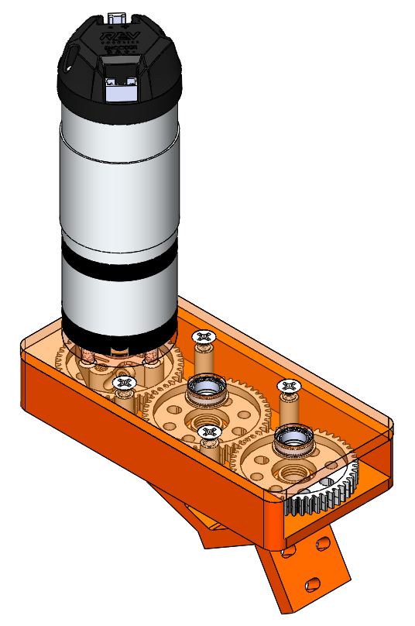
Gear Drive
Gear Drive is when a motor/servo rotates an object through side-by-side gear transmissions.
Motor
Driven Gear
Driving Gear
Output Gear

Slide 7
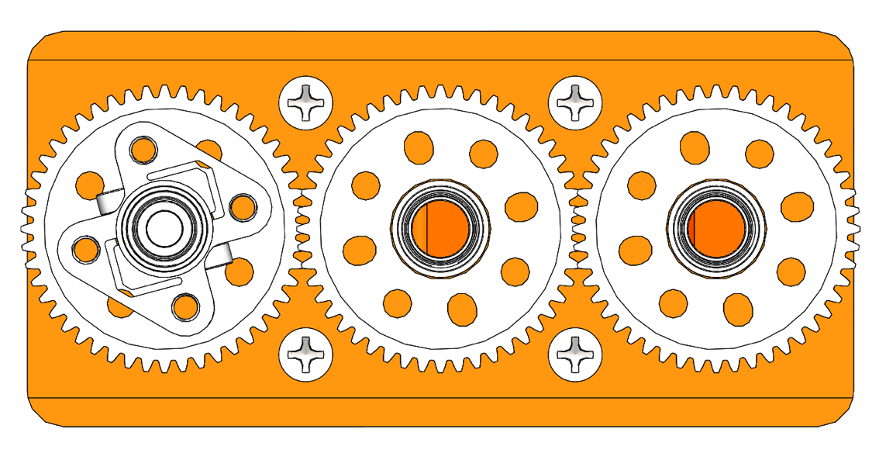
Gear Ratios
Gears, along with pulleys and sprockets, allow for reductions, which is the increasing or decreasing of speed and torque.
A larger driving gear increases the speed of the driven gear but decreases the torque.
A smaller driving gear decreases the speed of the driven gear but increases the torque.
Calculating Gear Ratios:
Number of teeth (Driving) : Number of teeth (Driven)
48 teeth : 48 teeth
1:1 Gear Ratio

Slide 8
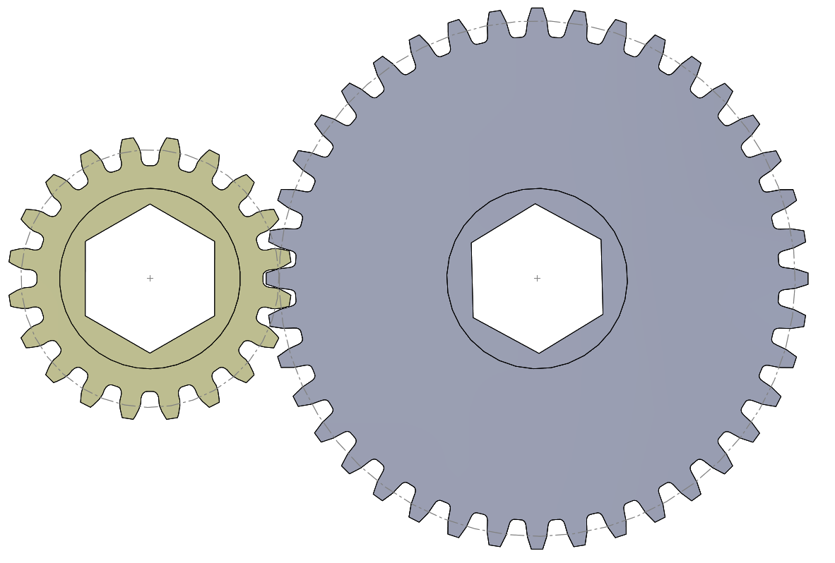
Gear Positioning
Gear driven transmissions requires gears to be set at precise distances from each other for optimal performance
For gears to work best together, the pitch diameters need to be tangent.
Pitch Diameter
Gear pitch diameters can usually be found on the vendor’s website

Slide 9
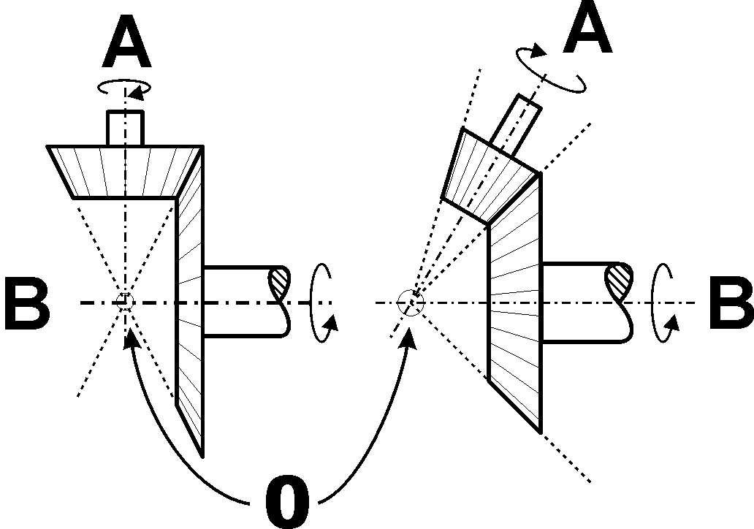
Gears at Angles
Gears can be used to transfer motion at angles as well
Specialized gears are required for angular transfer of motion, known as bevel gears.
There are two main types of bevel gears:
Standard bevel gears
Miter gears

Slide 10
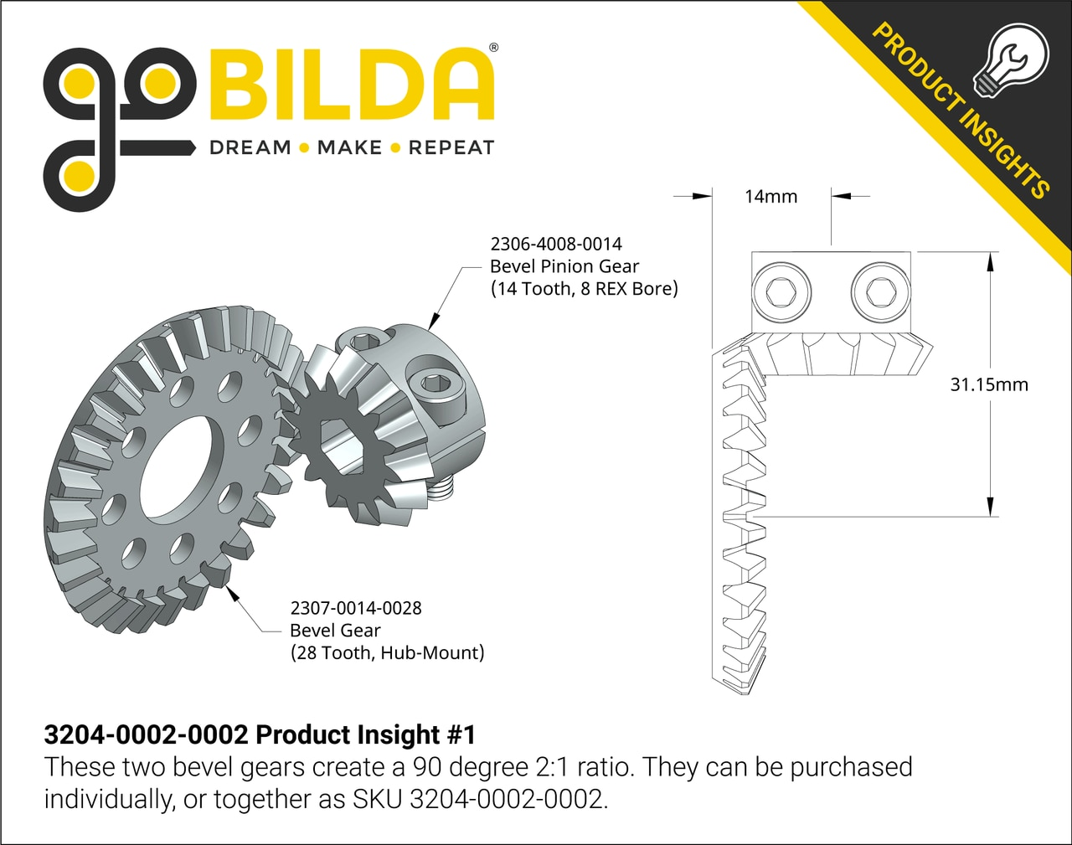
Bevel Gears
Standard bevel gears are used for non-90-degree angles or gear ratios other than 1:1.
Most common and reliable bevel gear is the 2:1 GoBILDA bevel gear set

Slide 11
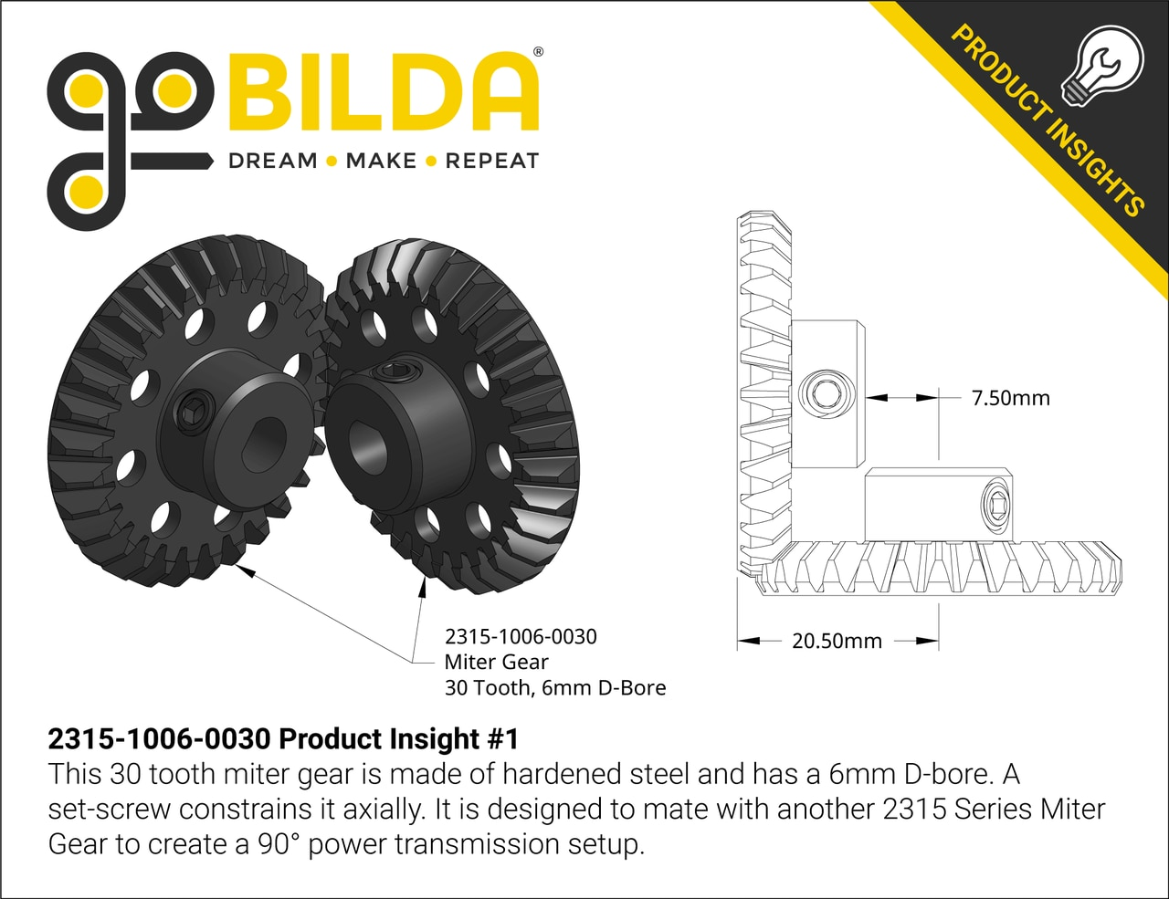
Miter Gears
Miter gears are specially designed for 1:1 90-degree angles
GoBILDA’s miter gears are extremely reliable COTS (Commercial Off The Shelf) parts for use in these situations

Slide 12
Gear Drive Pros & Cons
Pros:
Easy use of reductions to increase or decrease speed and torque for the final output
Specialized gears such as bevel gears allow transferring rotation at angles
More compact for transferring rotation over small distances
Cons:
Difficult to transfer rotation over long distances.
Small room for error when placing gears
Need to be a set distance apart for optimal performance

Slide 13
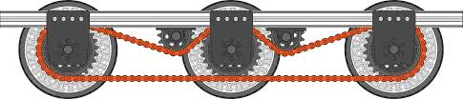
Chain Drive
Chain Drive is when a motor/servo rotates an object through chain-connected sprockets.
Sprocket
Chain
REV Robotics Chain Drivetrain

Slide 14
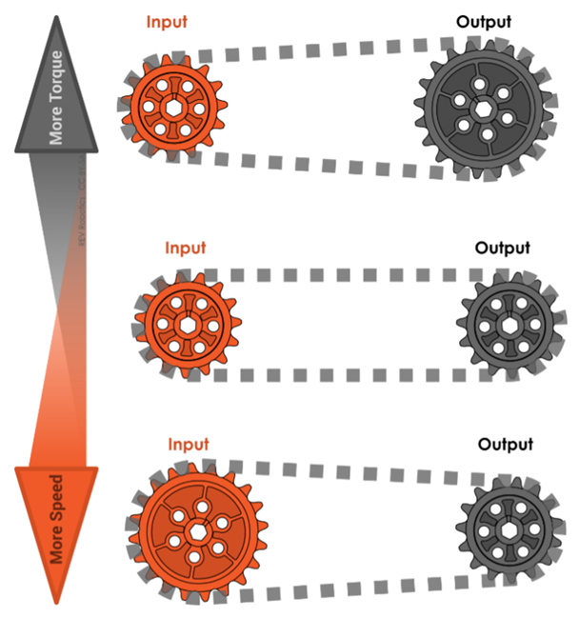
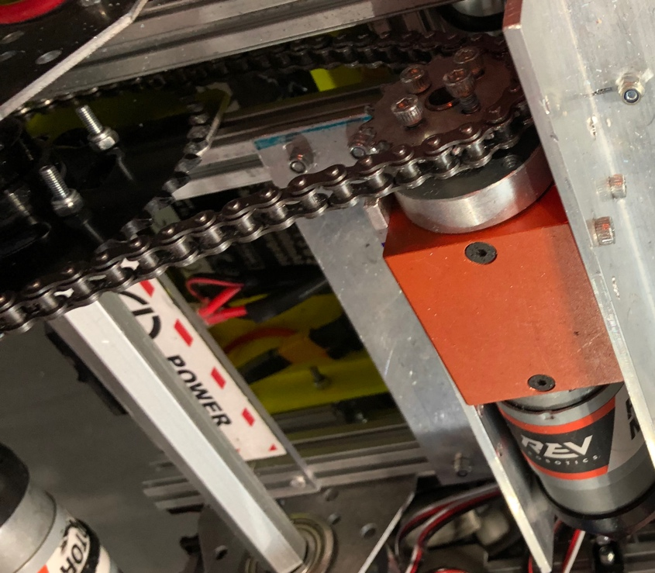
Gear Ratios With Chain
Gear ratios work the same way with sprockets as with gears.
A larger driving sprocket gives the driven sprocket more speed
A smaller driving sprocket gives the driven sprocket more torque
60 tooth sprocket
High-torque reduction from 18-19 season robot
REV Robotics Chain Guide
16 tooth sprocket

Slide 15
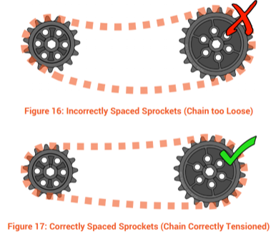
Sprocket Positioning
Positioning sprockets is much easier than positioning gears because of the leeway chain allows while still transferring motion
Even though chain allows more leeway, it is important to remove as much slack from the chain was possible.
The less tension in the chain, the more the sprockets will wiggle independently
REV Robotics Chain Guide

Slide 16
Sprocket Positioning Continued
In order to find the length of chain required for two sprockets a set distance apart, a chain length calculator can be used.
By searching for chain length calculators on the internet, various websites can be found that use the distance between and size of sprockets to determine the number of chain links required.
Most calculators can also use the chain length and sprocket size to calculate the optimal sprocket distance.
Some useful sites are:
http://www.botlanta.org/converters/dale-calc/sprocket.html
https://electricscooterparts.com/chainlengthcalculator.html

Slide 17
Chain Breaking
In order the adjust the length of the chain, it must be broken at the appropriate links and put back together.
Breaking chain and reconnecting it is extremely simple, and it can be reconnected in two different ways:
Using a master link
Resetting the chain
A great guide created by REV Robotics for chain breaking can be found here:
https://www.revrobotics.com/content/docs/REV-41-1442-UM.pdf
The above link uses the REV chain breaker, but it can be done with any chain breaker rated for the chain being broken (#25 chain breaker for #25 chain)

Slide 18
Chain Drive Pros & Cons
Pros:
Easy to transfer motion over large distances
More forgiving of spacing errors
Simple to put together
Durable
Cons:
Cannot transfer motion at angles
Slightly less efficient than gears and belts
A small amount of motion is lost to the sprockets wiggling independently.

Slide 19
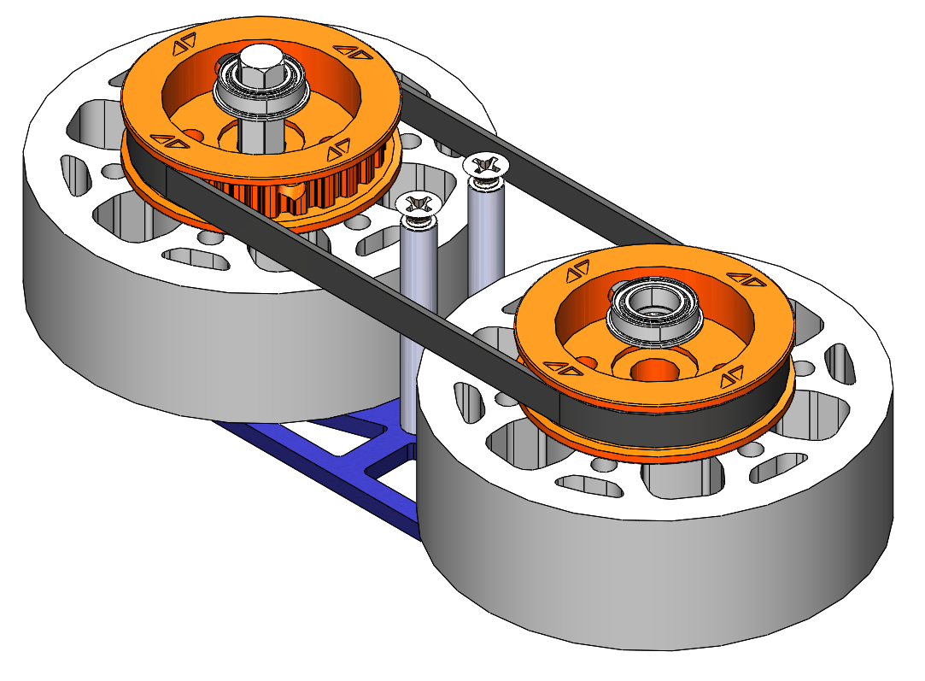
Belt Drive
Belt Drive is when a motor/servo rotates an object through belt-connected pulleys.
Belt
Pulley

Slide 20
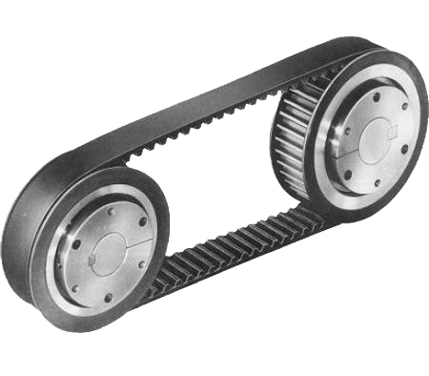
Timing Belt
The timing belt is the most used belt for FTC
Timing belts are belts with teeth on the inside to move the pulleys with more friction
Timing belt pulleys are similar to sprockets, however the teeth are usually shorter and smaller

Slide 21
Pulley Positioning
Pulleys need to be accurately positioned for belt drive to work
Too low tension prevents the belt from pulling on the teeth of the pulley
Too high tension snaps the belt
The best way to position pulleys is to use a belt length calculator
Very similar to a chain length calculator
The belt length calculator can calculate belt size given pulley size and spacing
It can also calculate pulley spacing given belt length and pulley size
Some calculators:
https://www.bbman.com/belt-length-calculator
https://sdp-si.com/eStore/CenterDistanceDesigner

Slide 22
Belt Drive Pros & Cons
Pros:
Extremely efficient
Easy to transfer distance over large distances
Quieter and lighter
Cons:
Need to be precisely positioned to work
Tension needs to be exactly right to allow the belt to work
More expensive than chain options
Difficult to prototype with

Slide 23

Credits
This lesson was written by The Antidote 14320 for FTCTutorials.com
You can contact the author at:
Website:
http://theantidoterobotics.com
Twitter:
@theantidoteFTC
Email:
theantidoteftc@gmail.com
More lessons for FIRST Tech Challenge are available at www.FTCtutorials.com
This work is licensed under a
Creative Commons Attribution-NonCommercial-ShareAlike 4.0 International License.

